Slide 1
Rhythm Steady Beat 1st Grade: Ta and Ti-Ti
KDG & 1ST GRADES
I Can Keep a
Steady Beat
I Can Move to a
Steady Beat
1st Grade:
I Can Clap Ta , Ti-Ti

Slide 2
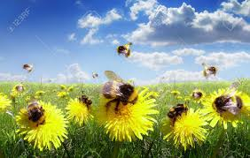
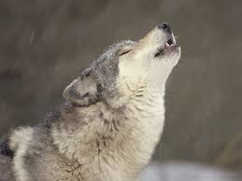
Warm Up Our Voices!
BZZZZZZZ
AHHoooooooo
MMMMMMMMMM

Slide 3
Hello There! (Echo Song)
Hello there! Hello there!
How are you? How are you?
It’s so good! It’s so good!
To see you. To see you
We’ll Sing and We’ll sing and
Be happy Be Happy
That we’re all here together again.

Slide 4
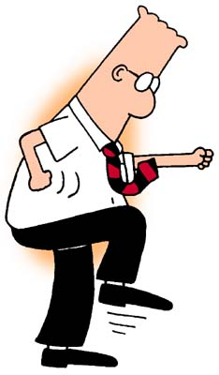
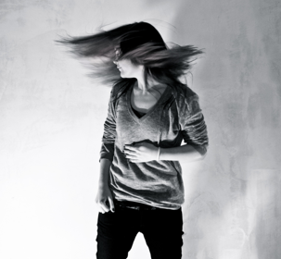
Keep the beat with your feet, body, hands, head…
Name other ways you can keep the beat!!
How can you show the Beat with your Body???

Slide 7
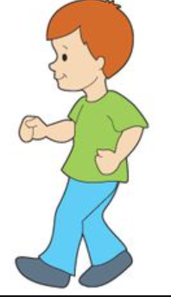
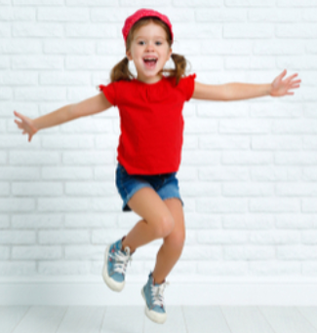
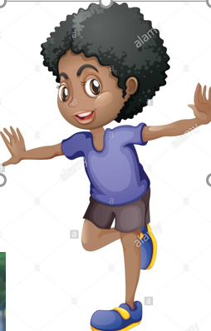
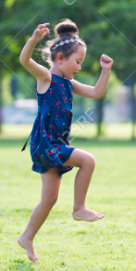
Rig a jig jig
walking
jumping
Rig a jig jig
running
hopping
skipping

Slide 8
Rig a jig jig
Slow walk
walking
Wiggle
Add new motions to the song.
jogging
Rig a jig jig
Skating
jumping
skipping
Walk a circle
hopping

Slide 9
Name these Notes and Rests!
TA Ti Ti SH
We use Ta’s and Ti’s to say the rhythm in music.

Slide 10
ECHO CLAP !
Clap the exact same rhythm
I clapped to you back to me.

Slide 11
Clap the rhythm
Ti-ti ta
When you sing shortnin’
Bread.
Ti Ti Ta
Shortnin’ Bread

Slide 12
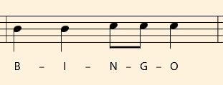
B I N G O
Ta Ta Ti Ti Ta
Clap it as you sing it!

Slide 13
B I N G O
B I N G O
Clap on the red
X’s and sing the letters .
Do the same think as you sing
Bingo.
X I N G O
X X N G O
X X X G O
X X X X O
X X X X X

Slide 15
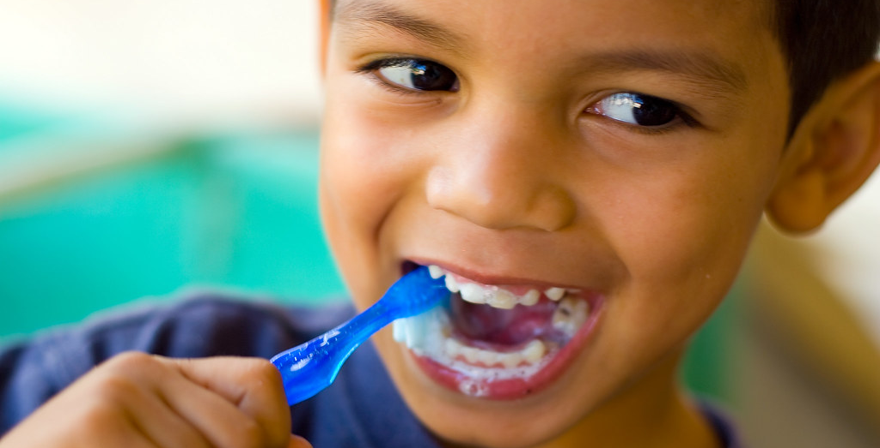
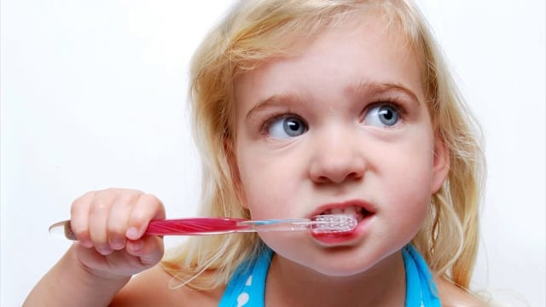
You Brush Your Teeth
1 2 3 4 5
Ch ch ch ch ch ch ch ch ch

Slide 16
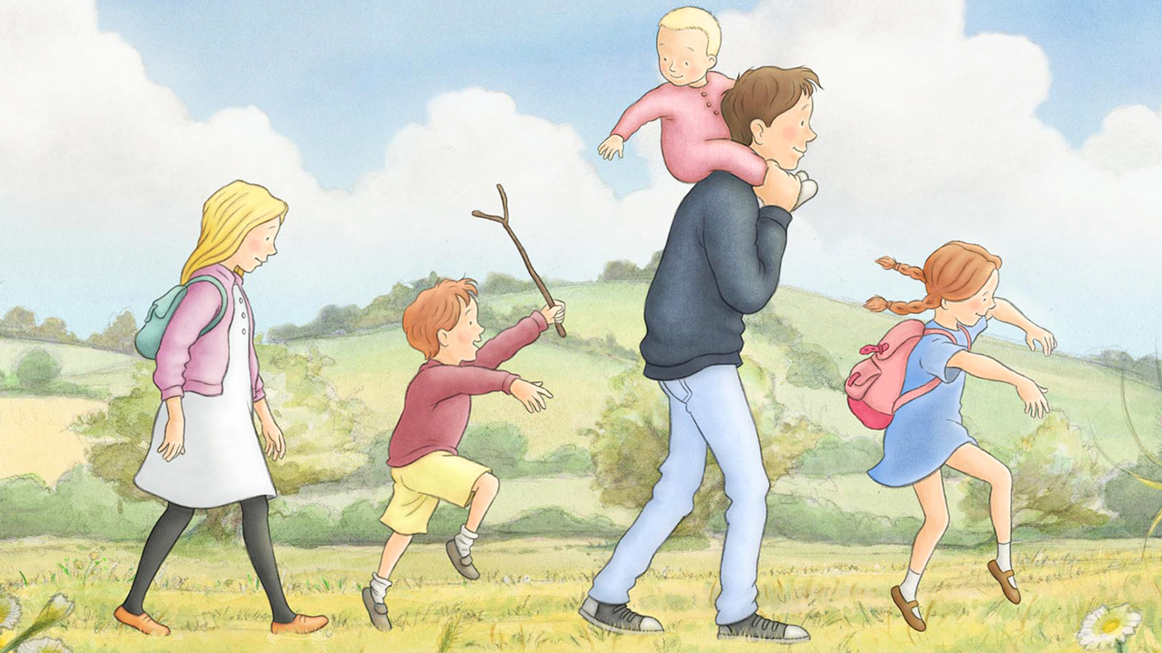
Going On A Bear Hunt

