Slide 1
4th and 5th Gr. Rhythms, Meter, Rhythm Composition I Can speak and play rhythms. I Can create a two measure rhythmic pattern.

Slide 2
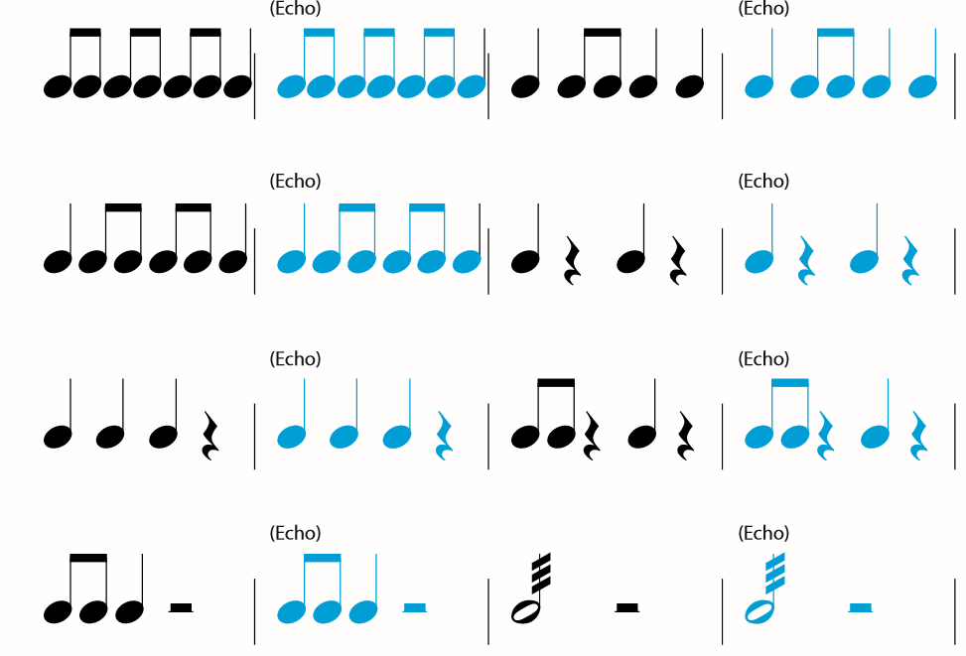

Slide 4
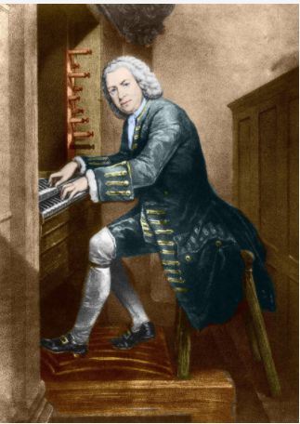
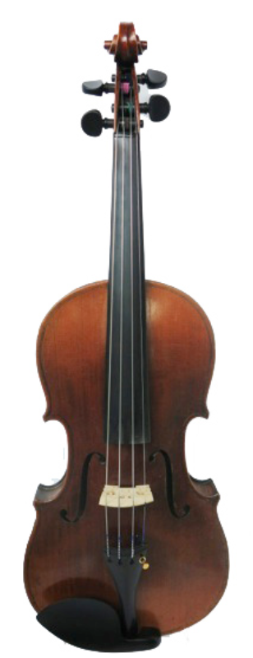
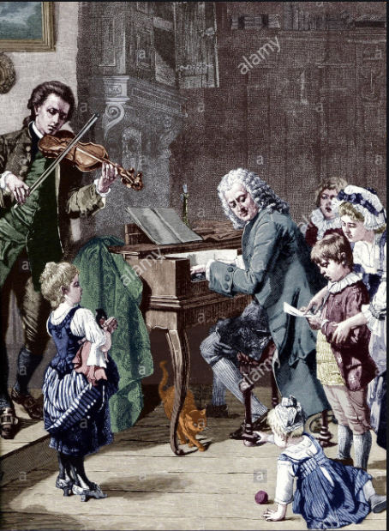
Johann Sebastian Bach 1685-1750
Bach playing the organ
1700’s Violin
Bach playing the clavichord

Slide 5
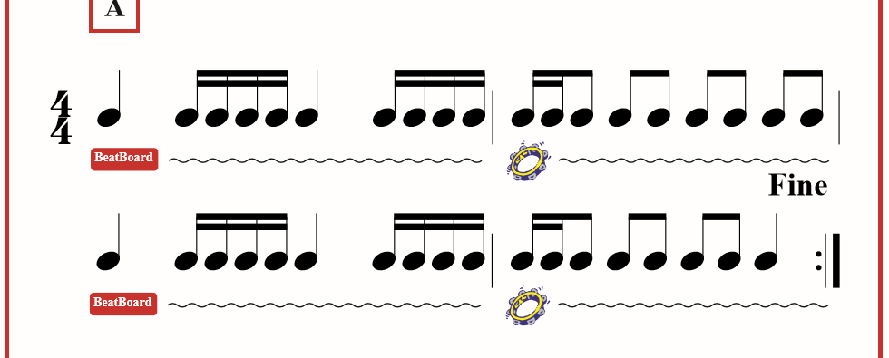
Musette in D major

Slide 6
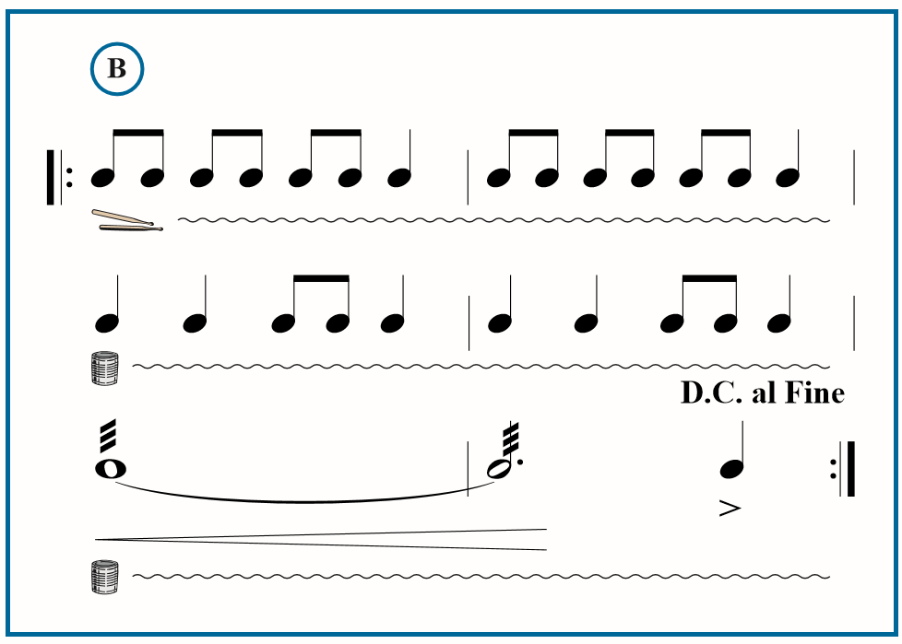

Slide 7
.
= 2 = 1 =1 =1 silence

