Slide 1
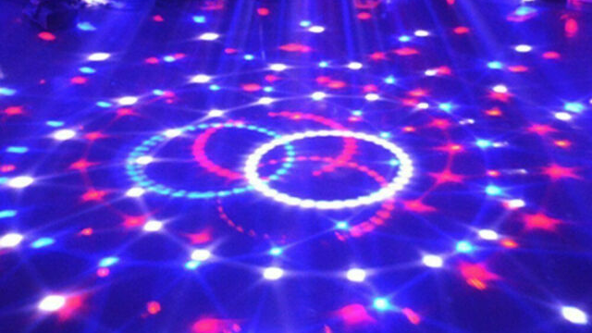
4th and 5th Grades
Rhythm
And Body Percussion
I can clap simple rhythms
I Can Perform Body Percussion
I Can Create Body Percussion

Slide 2
VOCABULARY
RHYTHM – patterns of long and short sounds, and
rests organized in a set time
Ostinato – a repeated rhythm or melody used to
provide unity in the music
Body Percussion – creating rhythm patterns on the
body using claps, stomps, taps, pats, etc.
Measures – barlines divide music into measures to
organize music and make it easier to read
Quarter note- equals one count of sound in 4/4 meter
Quarter rest – equals one count of silence in 4/4
Eighth note – equals ½ count of sound in 4/4 meter

Slide 3
ta
Practice reading rhythms…
Sh
Ti-Ti

Slide 5
OSTINATO
A CONTINUALLY REPEATED
RHYTHMIC OR MELODIC
PHRASE
slap clapclappatpat stomp repeat
44

Slide 6
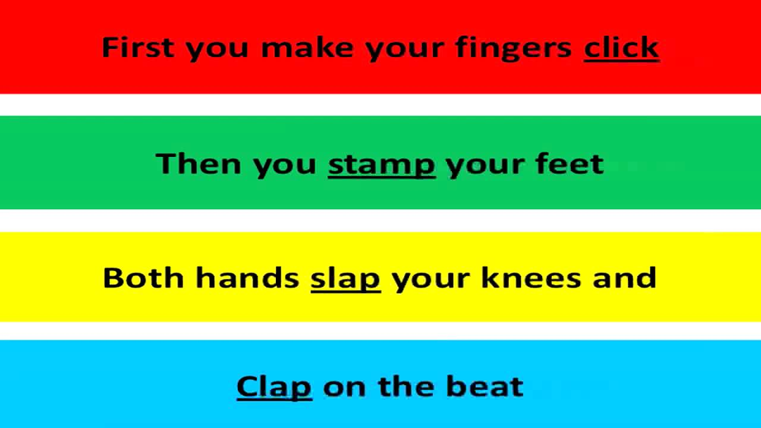

Slide 7
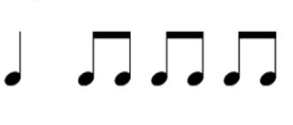
4
Meter in 4. Create Body Percussion to
Measure 1,2, or 3 using Claps, taps,
Pats, stomps, mouth sounds, snaps, etc.
Example for measure 1: Stomp,stomp, Clap, snap
You must use at least three different sounds.

Slide 8
Hand Jive to:
We Go Together

Slide 9
We Go Together
16 Count Ostinato
1,2
3,4
5,6
7,8
9,10
11,12
13,14
15,16
Pat, Pat
Clap, Clap
Right hand over left – 2 times
Left hand over right – 2 times
Right fist bump on Left – 2 times
Left fist bump on Right – 2 times
Right thumb over right shoulder – 2 times
Left thumb over left shoulder – 2 times

Slide 10
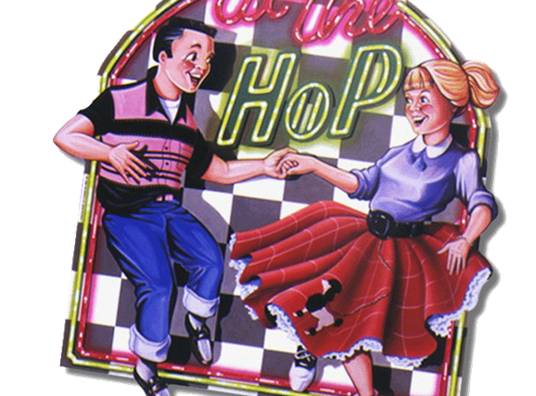
Let’s Go To The Hop
4x (16 counts)
Come On…
Let’s Go To The
Hop! (8 counts)

Slide 11
Let’s Go To The Hop!
8 Count Ostinato
Create a Body Percussion Rhythm-
An Eight Count Ostinato perform it 4x
Clap, clap
8 Measures of 4 counts in each meas.
Pat, pat
(thigh)
1234, 1234,
1234, 1234,
1234, 1234,
1234 1234
Pat, pat
(chest)
Brush, brush
Snap, snap
Step, step
Click, click

Slide 12
Directions for Flipgrid video.
You should create an 8 count body percussion and perform it with the chorus part of
At The Hop. You will repeat it 4 times during the chorus:
Let’s Go To The Hop
4x (16 counts)
Come On…
Let’s Go To The
Hop! (16 counts)
Hover mouse over At The Hop,
press ctrl and click, at Chorus - 0:32 begin audio
and add body percussion (8 count body percussion & perform it 4 times) Video your body percussion
with audio
At The Hop

