Slide 1
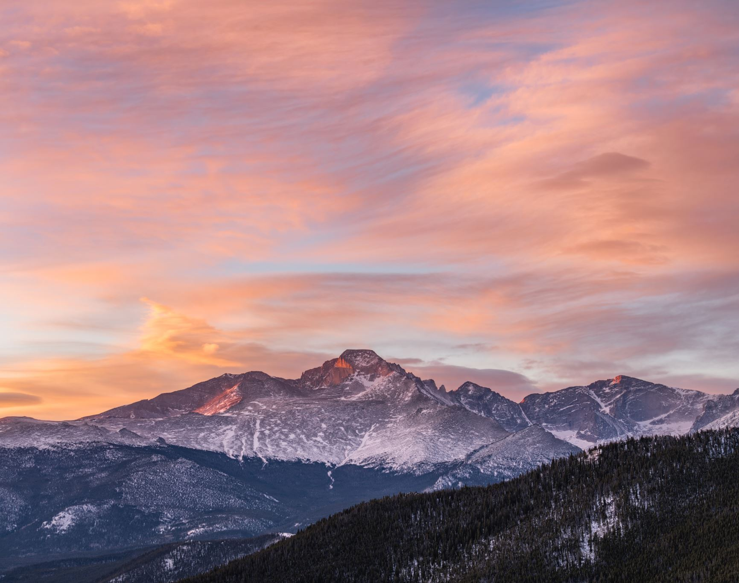
2nd & 3rd Grade Rhythm patterns, and ostinato
I CAN perform rhythm patterns
I Can perform
ostinatos
I Can create
and perform
rhythmic
ostinatos.

Slide 2
In the Hall of the Mountain King
From Peer Gynt Suite No. 1 by Edvard Grieg.
Learn how rhythm, dynamics, and tempo
shape a piece of music.
Let’s Learn the story of Peer Gynt

Slide 5
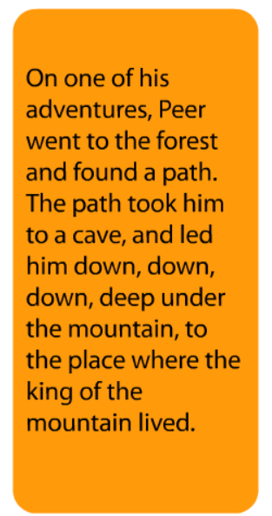

Slide 6
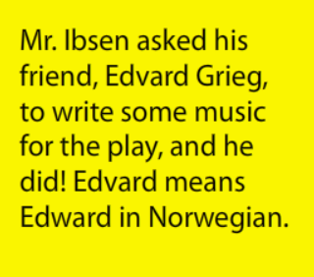

Slide 7
Where does the story take place? Norway
Name the countries around the location of the
Story. Finland, Sweden, Russia
Who is the story about? Peer Gynt
Who wrote the story? Heinrich Ibsen
Who wrote the music? Edvard Grieg

Slide 9
1
2
3
4

Slide 10
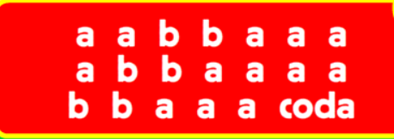

Slide 11
Rhythm practice of quarter and eighth notes:
In the Hall of the mountain king

Slide 12
Questions?
What did you notice about the dynamics or volume?
The music has how many sections of music.
How did Grieg use three elements of music to make the music more exciting?

Slide 14
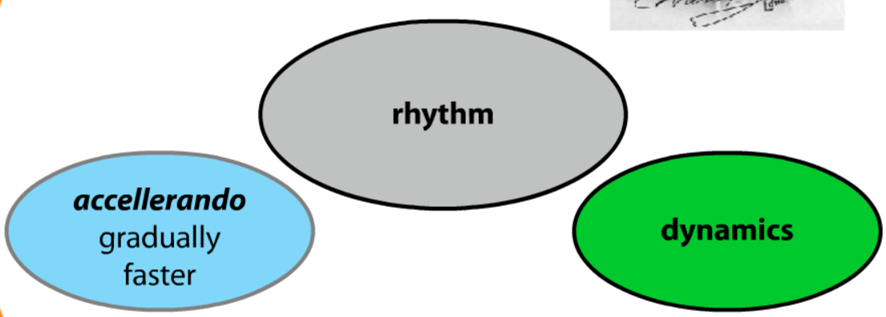

Slide 15
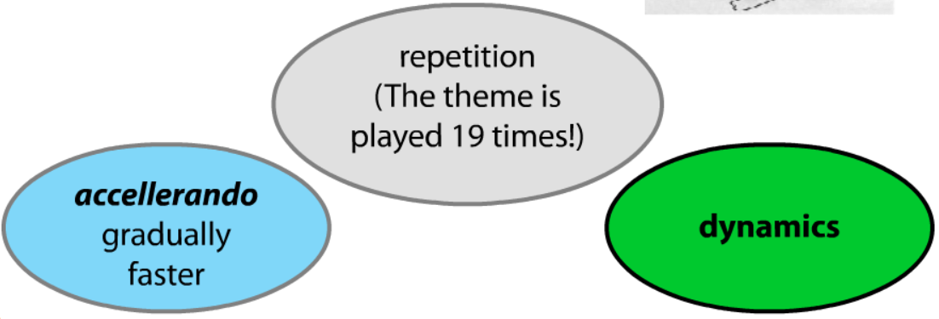

Slide 16
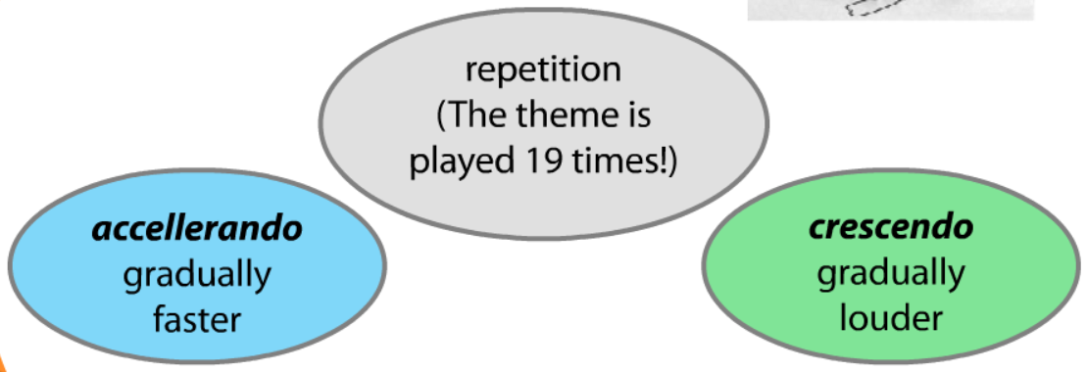

Slide 17
Orchestral Version of Hall of the Mountain King
Hall of the Mountain King

Slide 18
Body Percussion to Hall of the Mountain King
body Percussion example

