Slide 1
2nd and 3rd Grade Rhythm Meter/Rhythm Patterns
I CAN Play Rhythmic Ostinatos
I CAN Improvise rhythms over a steady beat.
I CAN self assess according to given criteria.

Slide 2
An Ostinato is a short repeated pattern. It can either be rhythmic or melodic.
Improvisation is to make up
music as you are playing it, but still follow the pulse of the music and/or the chordal Structure of the music.

Slide 3
Improvisation: To make up music as you are
performing it.
Jazz influenced all popular music, and some classical music by the use of Improvisation.
Performers always have an idea as to how they will improvise, but usually change it as they are performing.The improvisation changes from performance to performance.

Slide 4
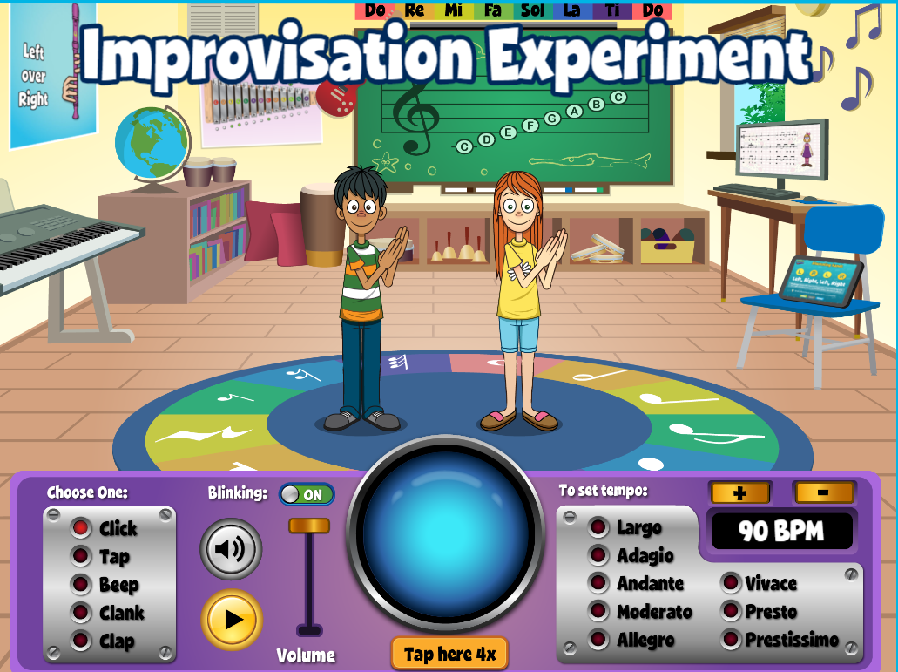
Listen to the pulse and create a rhythm pattern,
ostinato, that goes with it.
You will play the rhythmic
Ostinato with the pulse.
Did you stay with the pulse?
Quaver -
2nd, Ostinatos 2

Slide 5
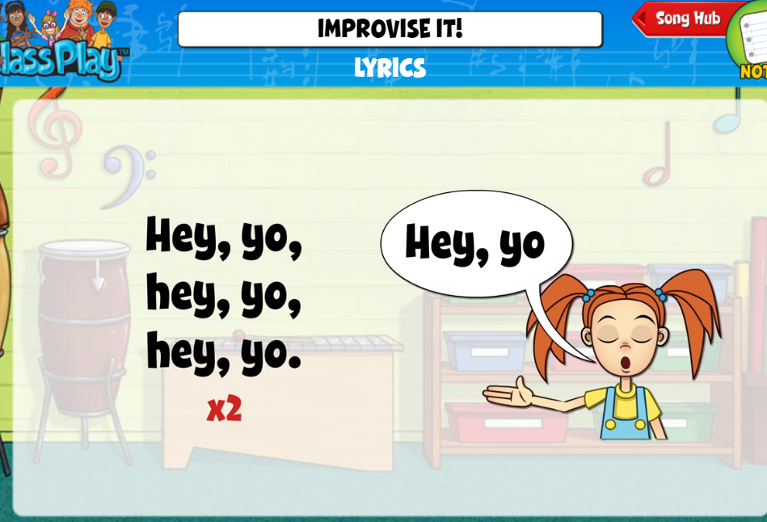

Slide 6
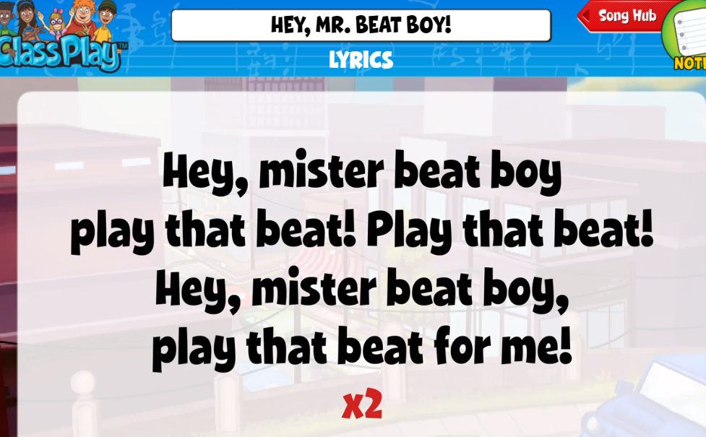
Quaver: 3rd,
Ostinatos

Slide 7
What a Wonderful World

Slide 9
